Slide 1
Introduction to Data Visualization and Types
Arif Istiake Sunny
Senior AI Engnineer
Brain Staion 23 PLC
Mobile: 01732009493
Email: sunny1506006@gmail.com

Slide 2
Contents
Exploratory Data Analysis
Seaborn styling set
Heatmap color styling

Slide 3
Exploratory Data Analysis
Teacher:
“Good morning, data detectives! 👀 Today, we’re going on a journey — not just into data, but into the heart of SunnyVille, a town full of secrets, weather changes, and even... pigeons with GPS trackers.”
🕵‍📈🌍

Slide 4
Exploratory Data Analysis
Teacher:
Once upon a time, in SunnyVille, the mayor was worried. People were complaining about power cuts, traffic, and even too many ice cream carts in some areas. So, she collected tons of data from surveys, temperature logs, electricity usage, and more.
Now, imagine you're her data scientist.
You open the Excel file. What do you see?
Some rows have missing values.
Some columns like “complaint_type” have strange typos like "Trafic" and "Traffick."
There are 10 types of ice cream carts in just one street. 🍦

Slide 5
Exploratory Data Analysis
Teacher:
Once upon a time, in SunnyVille, the mayor was worried. People were complaining about power cuts, traffic, and even too many ice cream carts in some areas. So, she collected tons of data from surveys, temperature logs, electricity usage, and more.
Now, imagine you're her data scientist.
You open the Excel file. What do you see?
Some rows have missing values.
Some columns like “complaint_type” have strange typos like "Trafic" and "Traffick."
There are 10 types of ice cream carts in just one street. 🍦

Slide 6
Exploratory Data Analysis
Welcome to Exploratory Data Analysis (EDA) — the art of understanding your data before doing anything else.
We ask:
What’s the shape of the data?
Are there missing or duplicate values?
What are the data types?
What's the average number of complaints per district?

Slide 7
What is Exploratory Data Analysis?
Welcome to Exploratory Data Analysis (EDA) — the art of understanding your data before doing anything else.
We ask:
What’s the shape of the data?
Are there missing or duplicate values?
What are the data types?
What's the average number of complaints per district?

Slide 8
What can you do?
You use:
Histograms
Box plots
Correlation heatmaps
Bar charts
And slowly, the messy jungle of numbers becomes a clear story.

Slide 9
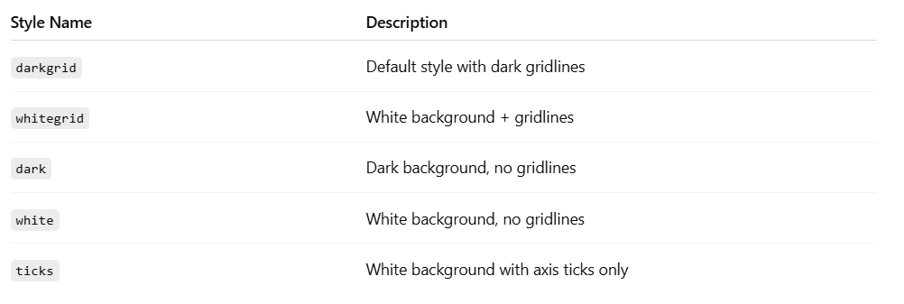
Seaborn styling set

Slide 10
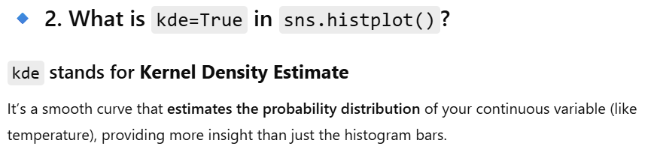
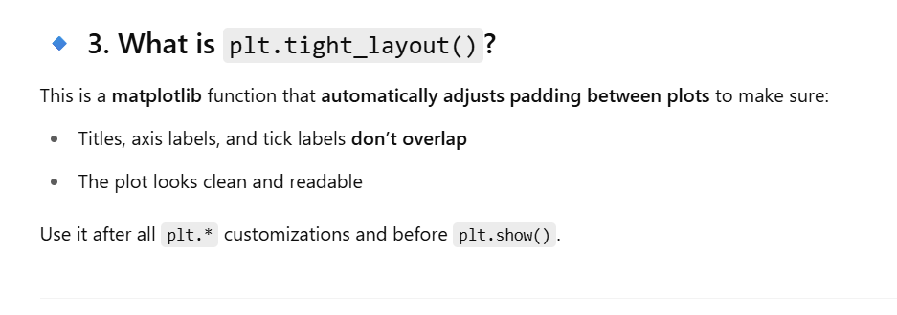

Slide 11
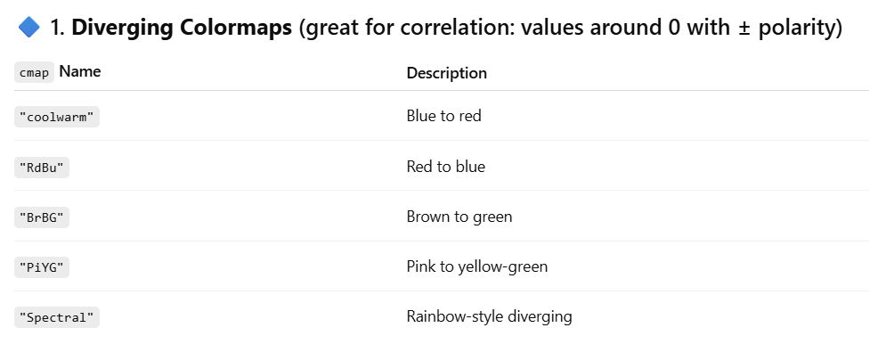
Heatmap color styling

Slide 12
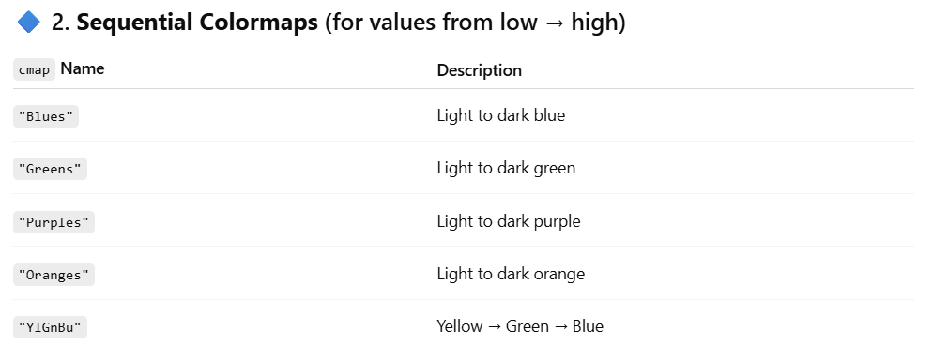
Heatmap color styling

Slide 13
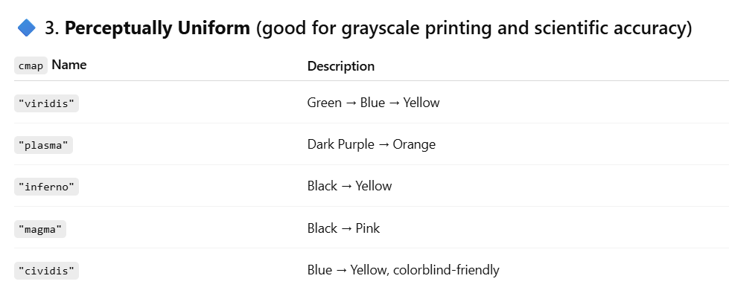
Heatmap color styling

